Slide 1

Project Pitch: Breast Cancer Mortality
Presented by Zariyah Williams & Addi Johnson

Slide 2

What is our project?
Our project focuses on breast cancer mortality rates in the United States in 2019. Our project benefits people affected by breast cancer, as well as their families and communities. Understanding differences in mortality can help raise awareness. The Institute for Health Metrics and Evaluation (IHME) collected data and produced estimates of breast cancer mortality. Our dataset contains 7,148,629 cells of data and includes variables such as race, location, age, cause of death, and gender. We plan to use these variables to explore how breast cancer mortality rates vary across geographic locations and demographic groups.
Notes:
Our project focuses on breast cancer mortality rates in the United States in 2019. This is the most recent publication of verified mortality rates. We believe our project benefits people affected by breast cancer, as well as their families and communities. Understanding differences in mortality can help raise awareness. The Institute for Health Metrics and Evaluation (IHME) collected data and produced estimates of breast cancer mortality. Our dataset contains 7,148,629 cells of data and includes variables such as race, location, age, cause of death, and gender. We plan to use these variables to explore how breast cancer mortality rates vary across geographic locations and demographic groups.

Slide 3

What did we want to study?
Research question(s)
Does race have a correlation with breast cancer mortality rates?
Is there a correlation between breast cancer mortality and age?
Is there a connection between breast cancer rates and county?

Slide 4

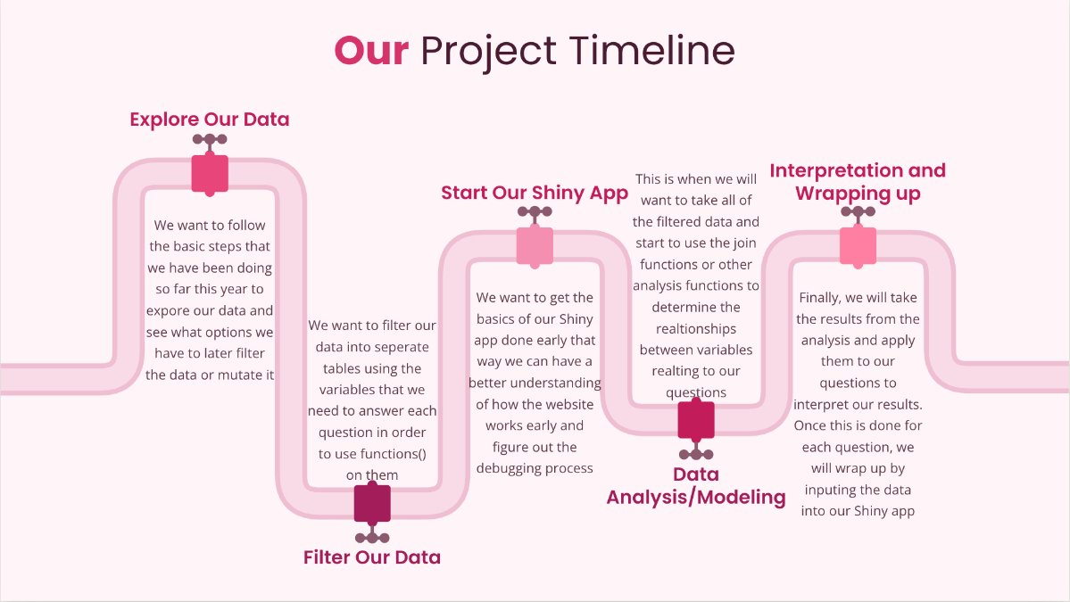
What is our plan?
For Our Analysis:
We want to use multiple different charts to investigate our questions, these include scatter plots, density graphs, histograms, and others
To interpret, we will look at correlational data, since we cannot imply causation on any of this data because nothing was manipulated

Slide 5

Our shiny app
Our Shiny app will feature an interactive map of the United States showing breast cancer mortality rates by county in 2019. Users will be able to filter by state or county and select different racial and ethnic groups to compare mortality rates. The app will also include a bar chart comparing rates across racial and ethnic groups and a data table showing county-level information. This connects to our research question by helping us explore how breast cancer mortality differs geographically and across racial and ethnic groups. The public could use the app to learn about these disparities, while policymakers and healthcare workers could identify areas and populations that may need additional healthcare resources and support.

